Slide 1
Data – deriving asset value

Slide 2
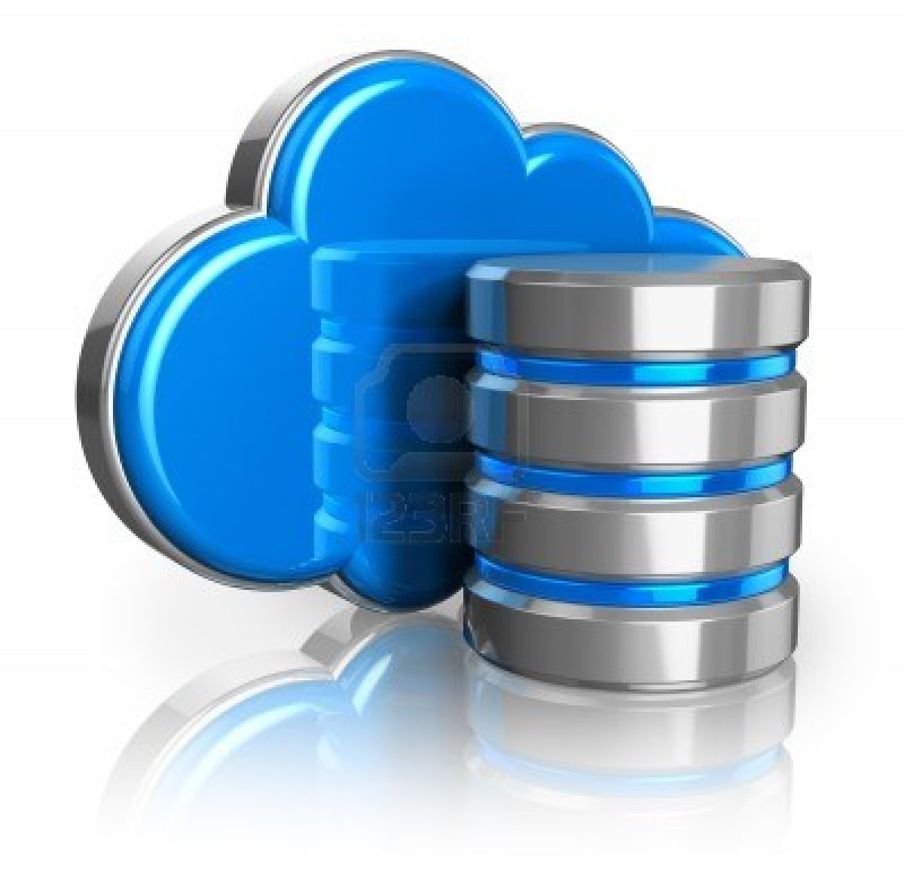
Is data an asset?
Notes:
Institutional assets are well known: Staff, Finances and Estates. Platform for success. Aligned to objectives, reuse without rework (think estates), professional staffed, will have a strategy (again in line with objectives), training and governance. Data is not like this because it is in silo, everyone does a bit of it and because of that it’s very complex due to integration between silos. This is inefficient and increases risk. Data needs the same respect, care and governance as the other three assets otherwise it will not change. And current situation is not sustainable.

Slide 3
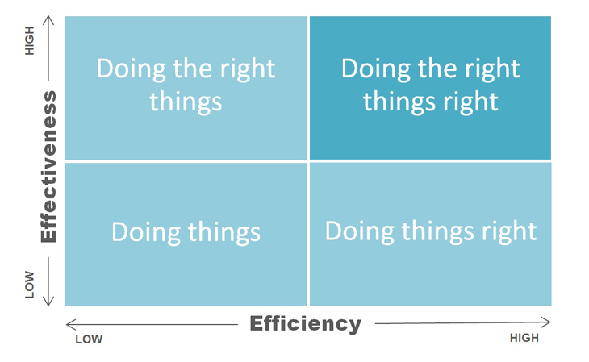
How to manage that asset?
Notes:
If you align business with data, one or more of these things will happen:
Benefits from efficiencies
Benefits from avoiding or mitigating risk
Benefits from creating more revenue
Data is more like fuel than oil. Traditionally it lubricates processes, in 21st century it fuels new opportunities. But it is volatile and it can explode!

Slide 4
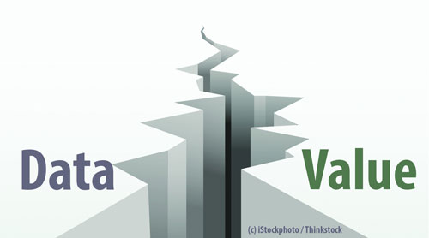
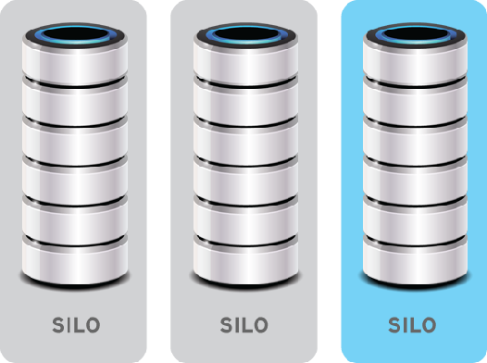
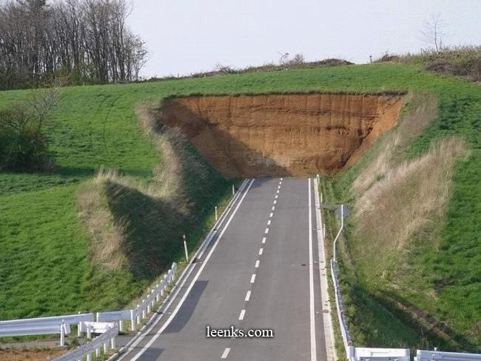
Where are we now?
Notes:
The way data is valued and managed are not consistent – huge issue as senior management don’t see the problem because they don’t recognise the complexity. We need new messaging. And we need to be brave enough to surface complexity.
Data is in held primarily in silo. As there is no governance (end to end), use follows organisational hierarchy. And this creates architectural debt,
Business and operational processes are not joined up. Data management does not follow business process. Risk/Cost/etc. Spending money twice.
Lack of ‘end state’ means solving data problems can make things worse! If you don’t know where you’re going you’ll end up somewhere else.

Slide 5
Why is it hard to change?
Data silos follow organisational silos
Changing everyones relationship with data
Value of this change is not well understood
Senior leadership have yet to see the opportunity
Suspicion of data being ‘centralised’
Poor technology choices and implementations
Notes:
This is not ‘planning doing things better’ or people associated with data, needs to be everyone. Need to explain the value, not just expect everyone to understand, need to show value of change (objectives again) and S/L MUST talk the talk and walk the walk. Seen as exemplars of treating data as an asset. Do not underestimate how suspicious many (mainly academic side) are of providing data so it can be shared/aggregated. Context is everything to these groups and rightly so. So it’s a conversation not a mandate. Technology is in support, do not allow ‘IT projects’ to create silo’d data pots.

Slide 6
What are the most common blockers?
Business Intelligence or ‘arguing about whose data is right’
The metric desert or ‘measuring angels on a pin'
The ‘I don’t do data’ or ‘I do my own data’
The data has no value to me or ‘I don’t understand it’
We don’t have time or ‘we don’t see the value’
Notes:
Get DQ and MDM right and you can talk about what the data means not whose data is right. BUT also needs literacy to make sure everyone feels comfortable with presentation of data. Know your audience. Do not create KPIs by the hundred. Spend more times creating measurements than using them. Rigorously challenge – what is it for/what data is needed/at what quality/from what source/for how long/etc. – if you have BA’s get them involved.
Need to change messaging so data is seen as supportive of individuals not a burden. This is a people led change.

Slide 7
What interventions can we make?
Senior leadership messaging
Accuracy and integrity
Structure and purpose
Access and delivery
Trust and security
Benefits tool
Use the findings of this project
Find objectives these will support
Do not own the consequences of poor decisions!
Notes:
Taken from SROC presentation where VC at Loughborough talked about his ‘data being well managed’ because of those four things. Toolkit can support this by showing real benefits. And if you cannot make changes due to lack of support, consequences are owned by the individual who did not support you!

Slide 8
Call to action
Our world is changing
Data must be at the heart of that change
That change transforms data to be an asset
Change must be driven top down
Doing nothing is not an option
Notes:
Keep telling people this ☺

Slide 9
Contact details
HEDIIP Data Capability toolkit
- www.hediip.ac.uk/datacapabillty
Community of practice: https://www.linkedin.com/groups/8319542
My details
alex@leighpartnership.com
@alexleigh67
www.linkedin.com/in/alexleightlp

