Slide 2
Our journey

Slide 3
History in the making
1993
First Destinations Supplement
2018
Graduate
Outcomes
1972
First Destinations Record
2002
Destination of Leavers from Higher Education
1984
Exam results and First Destinations Supplement

Slide 4
What’s the wider context?
Attracting prospective students
Providing quality for current students
League tables
Policy,
funding and regulation
Data needs for HE providers
Higher Education sector

Slide 5
Graduate Outcomes aims
Future proof
Improve efficiency
Fit for purpose
Support legislation
Fundamental consideration of future data requirements
Improve efficiency of data collection
Revisit methodology to ensure fit for purpose for current usage
Take into account recent legislative developments and support developing ones

Slide 6
We listened…
Events
Conference
Review groups
Research reports
Articles and
blogs
International interest
Two consultations

Slide 7
The sector said…
99% said we still needed a survey (despite the availability of LEO)
92% said it should be a census survey of all graduates in the UK
63% supported the practicalities and management of our new model (methodology, governance, linked data and data outputs)
71% supported the implementation plan
84% supported the new survey design

Slide 8
The result! A model built on…
High
quality
Consistent quality
Minimised
risk
Minimised complication
Minimised
cost

Slide 9
A model for the future
Overseen by a
sector steering group
Using linked
data
Annual survey
15 months after graduation
Run centrally

Slide 10
The survey

Slide 11
The survey questions
Includes number of jobs, full or part time, SIC, job choice, salary
Traditional employment questions
Includes self-employment, running a business, SIC information, funding, salary
Non-traditional employment questions
Includes number of previous jobs or study
Early destinations
Includes full / part time, qualification type, provider name and location
Study, training or research
Graduate voice measures
Subjective wellbeing measures
My current work / study fits with my future plans
How satisfied are you with your life nowadays?
My current work / study is meaningful
To what extent do you feel the things you do in your life are worthwhile?
I am utilising what I learnt during my studies in my current work / study
How happy did you feel yesterday?
How anxious did you feel yesterday?

Slide 12
Are these the right questions?
The survey has gone through extensive cognitive testing. This process determined the most effective questions for inclusion in the survey.
Graduate Outcomes survey
Robust
Adaptable
Future-proofed
Caters for provider needs

Slide 13
What will it tell us?
Graduate
career paths
Richer insight with voice measures
Graduate development since studies
We should celebrate our success
New
definitions of graduate success
Improved
overall
accuracy

Slide 14
Engagement

Slide 15
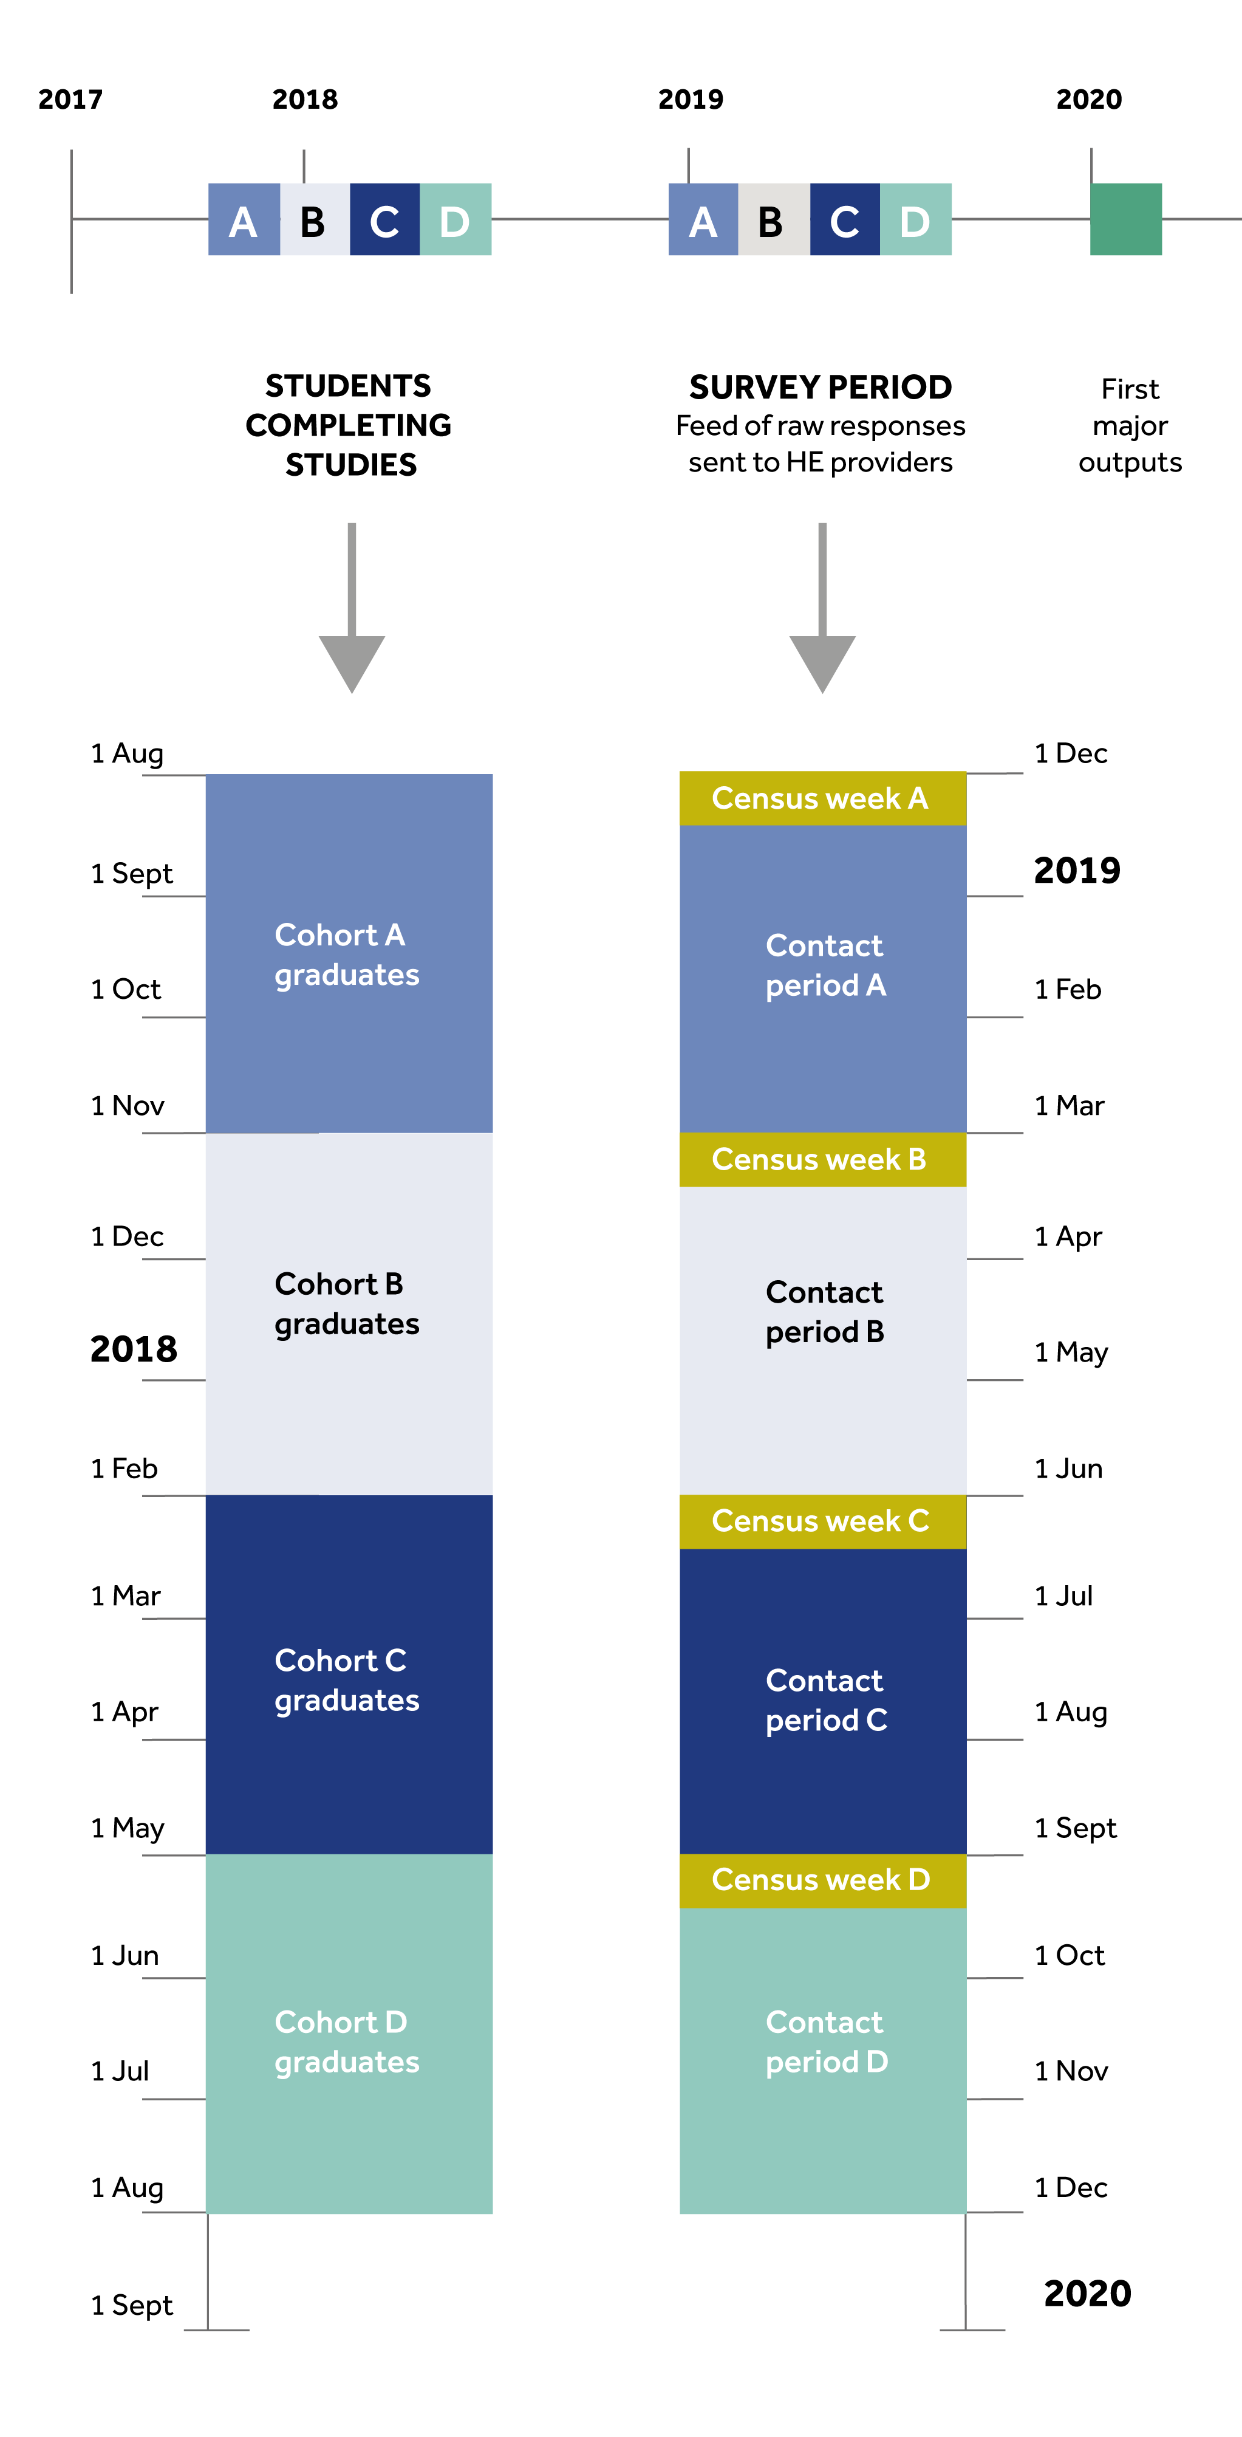
Survey timelines
Graduates are split into four groups (cohorts), determined by when they completed their studies.
They are surveyed 15 months (or so) after as shown in the diagram.

Slide 16
Engagement strategy
Primary
contact method: Email
Supported by:
text messages
Supported by:
phone calls
Email invitation from their HE provider. Contains online link to survey to Confirmit system
Supported by text reminders. Contains online link to survey to Confirmit system
Phone calls from call centre supplier on behalf of provider. Attempts survey completion by phone.
This relies
on the
quality and accuracy of contact details for each graduate
Managed by our contact management system over a 12 week period per cohort
Supported by provider and HESA driven communications activity

Slide 17
Our approach to contact management
No response
Initial email survey invitation. Follow ups by email and text
Third party
survey
completion
No response (yet) or no email address
Survey
complete
Survey complete

Slide 18
Provider role
Helps the response rate
Enables surveying
Personalisation survey features
Submission of contact details into the provider portal
Analysis
of data (dashboards)
Driving internal engagement to drive change
Drives quality contact details
Supports recognition and drives the response rate
Collecting and maintaining contact details
Promotion to students and graduates

Slide 19
Communications

Slide 20
Graduate Outcomes led communications
Nov
18
Oct
Graduate Outcomes
website
launches
Nov
18
18
Building a
social presence
Further brand assets released
- including video
animation
2018
Provider comms activity - ongoing
Ongoing
Targeted
test and learn activity
Creation of brand and asset bank
Click to visit »
Wider sector presence e.g. partner activity,
PR
2018
Ongoing

Slide 21
We have created a strong and vibrant brand…
Visit our brand asset bank
incorporate into your own channels
personalise to your brand
engage with ‘Graduate Outcomes’ led communications

Slide 22
Key dates

Slide 23
Key dates
Return of Student contact details
Provider logos uploaded to provider portal (to personalise the survey)
Opt-in question banks sign off by Head of Provider
Return of AP Student contact details
Cohort A starts…
9
9
13
28
3
Nov
Nov
Nov
Nov
Dec

Slide 24
Find out more…
www.graduateoutcomes.ac.uk

